Slide 1
Managing User Identities & Access
Challenges in Enterprise

Slide 2





Identity & Access Management
Right Access
IAM
Right Time
Right People,
Systems & Devices

Slide 3



Identity Lifecycle
Relationship
Begins
Relationship
Ends
Promotion
Location change
Business policy change
Change of Project
M&A
Employee, Contractor
Partner, Vendor, Joins Organization
User Leaves Organization
Create Identity (User Accounts)
Assign Resource Access
Access request & Approval
Password Self Services
Profile Management
Access Recertification
Revoke Access
Delete Accounts
Provision Access
Manage Access
Deprovision Access

Slide 4


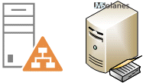







Identity Management System
Ticketing System
IAM Analyst
Data Feed
Provision Access
HR System
Enterprise App
Identity Management
System
Contractor
DB
Enterprise App
Enterprise
Directory
Servers

Slide 5





Identity Management Use Cases
Joiner/Mover/Leaver
Detect user events from Source of Record and create/manage/revoke identities within identity management system. Evaluate job roles and assign birth right access and roles
Self Service
Manage the users own profile and passwords.
Access Request and Approval
Process and workflows to request additional access and provisioning the access with appropriate approvals.
Access Certification
The process and workflow to periodically review the access my managers/application owners and rectify outdated access.
Role Management
Grouping of access into roles based on Job function and managing the lifecycle for Roles.

Slide 6
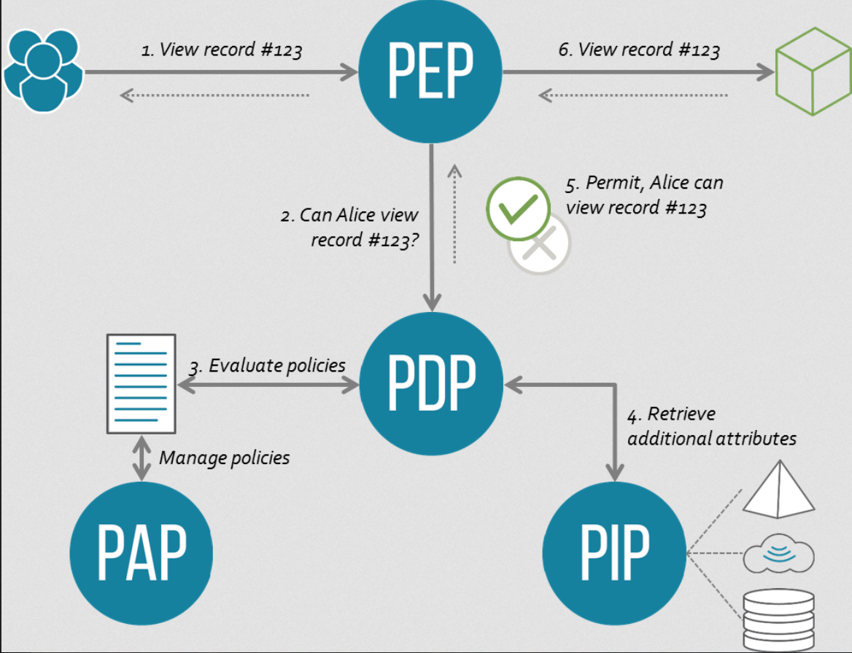
Access Management with Policies

Slide 7
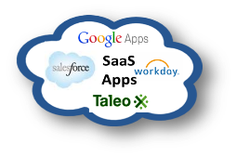



Access Management System
Federated
Access
PEP
Cloud/Saas App
Web Server / Proxy with
WebAgents
Enterprise App
PDP
Access
Management
System
PAP
PIP
User & Policy
Repository

Slide 8






Access Management Use Cases
Authentication & Authorization
Identify users based on supplied credentials and allow/deny access based on configured policies
Single Sign On
Log in once and access all authorized application without additional login .
Session Management
Manage active and inactive sessions and terminate sessions as needed.
Federation
A trust based authentication mechanism that can span across enterprise boundaries. Supports federation standards SAML, OAuth, OpenIDConnect, WS-Fed etc.
Multifactor Authentication
Require more than on factor of application for authentication.
Risk Based Authentication
Dynamically applying additional controls based on risk score captured on non standard context.

Slide 9





IAM Blueprint
Private Cloud Apps
Applications
Directories
HR System
Servers
Helpdesk
Database
Partners
API
Mobile
Security
Admin
Employees /
Contractors
Access Management
Data Governance
Privileged User Management
Authentication
Authorization
Data Profiling
Data Access Controls
Request Based
Restrict
Enforce
Web SSO
Risk Based
Mobile & Social
Fine Grained
Risk Based
PKI
Cryptography
Time Bound
Monitor
Multi-Factor
Identity Federation
API Interfaces
DLP
Certificate Management
Identity & Access Governance
User Life Cycle Management
User Self Service
Provisioning and De-provisioning
Role Based Provisioning
Business Policies & SoD
Delegated Admin
Access Request
Access Recertification
Role Management
Identity Analytics
IAM Governance
IAM Governance Council
IT Security Polices and Procedures
Regulatory Compliance Checks
Audit & Reporting

Slide 10




IAM benefits
Positive User experience
Increase Operational Efficiency
Increased Agility and Scalability
Reduce Access Control Risk in the Enterprise
Meet Compliance requirement

Slide 11

IAM Challenges

Slide 12
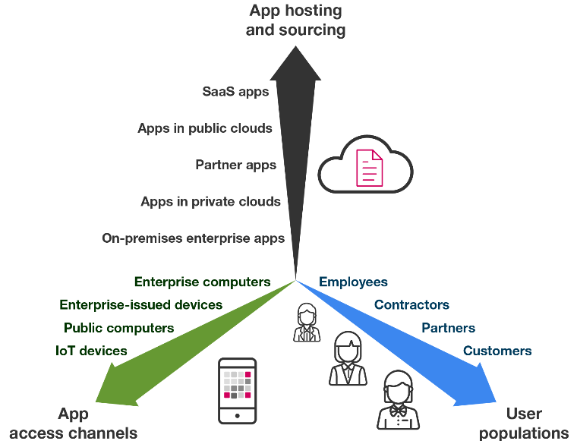
Expanding Boundaries

Slide 13
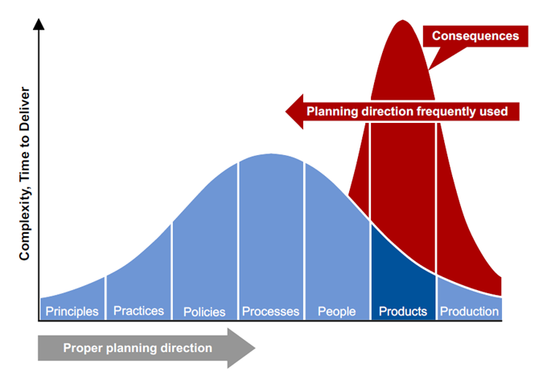
50% of IAM projects never reach production

Slide 14

Cross functional teams without alignment
How does this help me?
I need full control of IAM?
CIO : Lets get this to work
Not from my budget
I do not have the
bandwidth to support this
I need to retain control of my
application access

Slide 15
Other Challenges
Multiple Identities
Orphan Accounts
Manual Tasks
Complex Business Process
IAM as the Swiss Army Knife
Lack of Governance
Lack of Clear Roadmap & Architecture & Planning
Budget

Slide 16

What are Smart Enterprises doing ?

Slide 17






Cognitive era technologies such as AI, NLP, ML and RPA have matured and are delivering significant benefits to industry adopters
Cognitive & AI
Machine Learning, NLP & Chatbots
Automation Engine & RPA
Agile
DevOps

Slide 18


Cognitive IAM helps in significant increase of IAM solution efficiency and coverage
RPA Bots
IAM Admins
Managers
Application
Owners
RPA Bots
IAM Operations
App
Onboarding
Approvals
Account
Management
Source of Record
HR System
Contractor DB
IAM Platform
Approvals
Provisioning
RPA Provisioning
Manual Provisioning
Applications
Business Rules
Chatbot based self service
Workflow
Connected Provisioning
Ticketing
Tool
Process Optimization
Use cognitive capabilities to analyze HR feed and identify potential anomalies
Cognitive & AI to analyze feed and identify dynamic roles for users
Use cognitive capabilities to reduce approval request based on historical patterns
Chatbots to automate self service and eliminate ticket creation
NLP, ML & RPA for rapid application onboarding
ML, NLP & RPA to automate manual provisioning activities
Integrate RPA with closed loop remediation
Operations team onboard additional application into IAM Operations scope and transition to ML+RPA

Slide 19

Q&A
Response
Mitigation
Recovery

